Slide 1
Reduce

Slide 2
Reduce
Form:
reduce(function(x,y), list)
where f(x, y) is a function of two arguments and returns a value

Slide 3
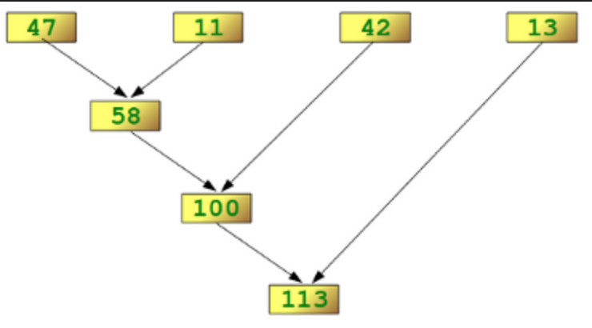
reduce(lambda x,y: x+y, [47,11,42,13])

Slide 4
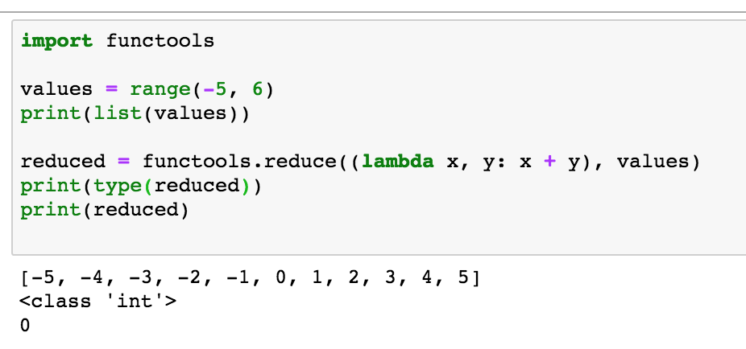
Example

Slide 5
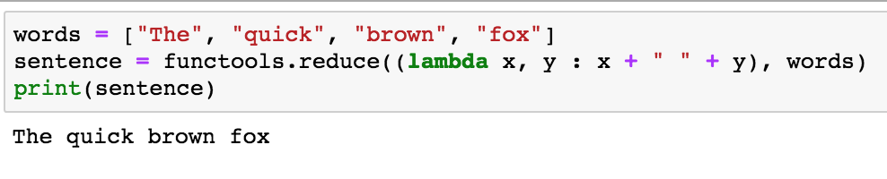
Another Example

